Slide 1
Introduction to Web Design and Applications
APT 1040
LECTURE 3B
By Bernard Ondiek

Slide 2
HTML - IMAGES
What is an image?
Types of images?
  <img src=‘http://www.myserver.com/images/mike.jpg’/>

Slide 3
Example
<html>
<head>
<title> Images</title>
</head>
<body>
<img src="C:\Users\bondiek\Desktop\preso.gif">
</body>
</html>

Slide 4
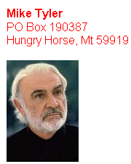
LAB 3

Slide 5
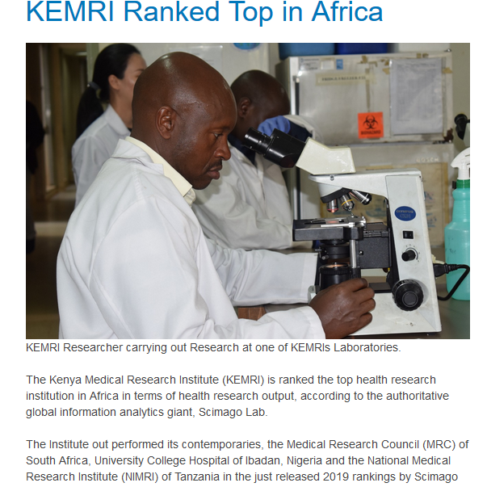
LAB 4

Slide 6
HTML - LINKS
ANCHORS (Hypertext Link)
<A href=“url” attributes>Displayed text </A>
Attributes
NAME = “text”
TITLE = "text"
TARGET = “frame_name|window_name”

Slide 7
LAB EXERCISE
1. Create a webpage with the following list
Heading- Tinga Tinga College
2. Then create a list with the below items
About us
Courses
Contact Us
Home
Save in a folder with the name home.html

Slide 8
<html>
<head>
<title>Tinga Tinga College</title>
</head>
<body>
<h1><center>TINGA TINGA COLLEGE</h1><br>
<b><font color="blue">
<a href=“aboutus.html”>about us</a><br>
Courses<br>
Contact us<br></b>
Home
</font>
</body>
</html>

Slide 9
Create three more files as listed below and save with the relevant names in the folder created earlier.
About us
Courses
Contact Us

Slide 10
HTML – Fundamentals
Hypertext links
<a href=“mywebpage.html” >Click this link </a>
Click this link
opens mywebpage.html in the window / frame named “window2”
window2

Slide 11
HTML – Fundamentals
Hyperlink Colors
<BODY LINK=color, VLINK=color, ALINK=color >
<BODY LINK=“blue”, VLINK=“purple”, ALINK=“red” >
<BODY LINK=“#0000FF”, VLINK=“#FF00FF”, ALINK=“#FF0000” >

